Slide 1
CSCI 331 – Group Project 2.5
Members: Timothy Dakis (Group Leader), Mikhaiel Gomes, Shivanie Kemraj (Backup Group Leader), Konrad Rakowski, Kevin Tang

Slide 2
Project Management
This section of the presentation will show aspects of project management, it will include:
The project plan
3 stages:
1) Planning Phase
2) Implementation Phase
3) Presentation Phase
Briefly speak of how the group assisted each other
Briefly speak about how RedGate toolbelt helped us during the project
Screenshots of all to-do lists by member
Screenshot of Gannt chart

Slide 3
The Project Plan
Our project was broken into three distinct phases, summarized as follows:
Planning Phase
This is where we would ask our initial questions to Professor Heller and then come up with ideas for the implementation phase
Implementation Phase
This is where we would implement things based off our plans
Presentation Phase
This is where we would make our slides in recordings showcasing the implementations

Slide 4
Planning Phase

Slide 5
Step 1: Analyze the Original Database To Figure Out Properties and Data of Each Table

Slide 6
Step 2: Figure out how to Split Tables, what UDTs to add, What Columns to Add/Remove, and What Constraints to add

Slide 7
Step 3: Review the Planned Changes

Slide 8
Implementation Phase

Slide 9
Step 1: Normalizing the Data Schema Tables
Implement the changes based on the plan
Log any anomaly or issues we faced
Adhered to the following name conventions:
Use PascalCase for Column/Table/UDT/Schema names
Primary Keys: PK_TableName
Check Constraints: CK_TableName_ColumnName
Unique Constraints: AK_ColumnName
Foreign Keys: FK_ChildTableName_ParentTableName
If needed to make a table that has the same name as something currently in the database, name is as [Data].[NewTableName]
E.g., when converting Data.Country, needed to make a Data.Country based on the details of the plan, named it Data.NewCountry
Group Leader compiles work, fixes issues in any INSERT SELECT statements, then remakes the [Data].[NewTableName] into just [Data].[TableName]
Also ensure to added any missing FKs that could not be added until all worked on tables were put together
Also updated Data.SaleByCountry to Data.uvw_SaleByCountry using the normalized database

Slide 10
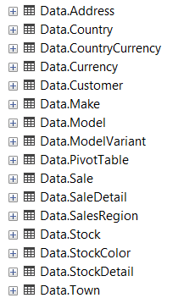
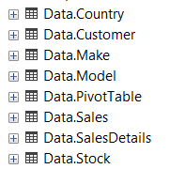
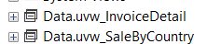
Data Schema Normalization Before and After
Before Normalizing
After Normalizing

Slide 11
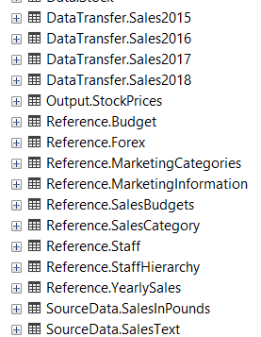
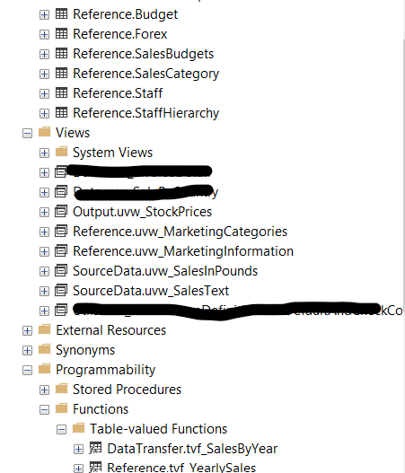
Step 2: Convert Non-Data Schema Tables into Views or Inline TVFs When Possible
Before Conversion
After Conversion: (Note: Crossed out Views unrelated to conversion)

Slide 12
Presentation Phase
Step 1: Make slides
Step 2: Record portions of the slides

Slide 13
Use of Discord, and how the Group Assisted Each other
No formal meetings held during the project

Slide 14
In Lieu of Regularly Scheduled Meetings…
We utilized Discord to organize and manage parts of the project and deadlines

Slide 15
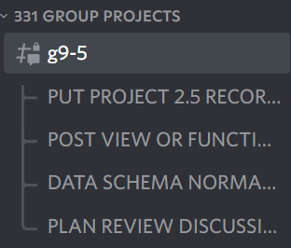
Example: to ensure everyone’s work is submitted, threads were used to compile results

Slide 16
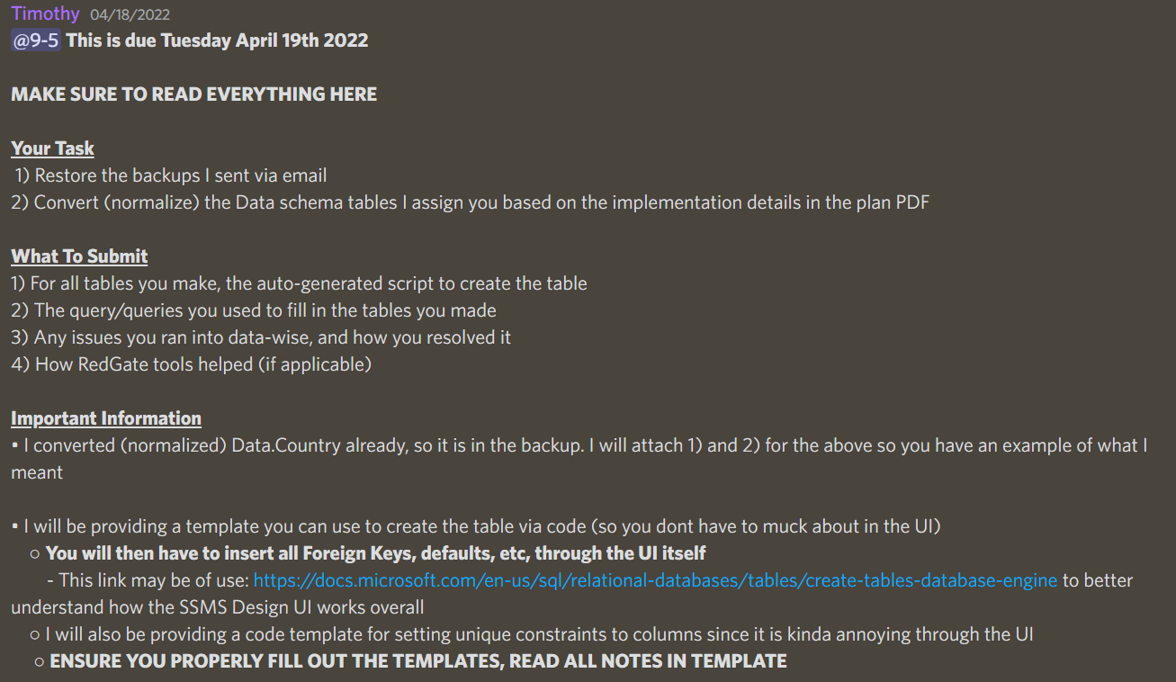
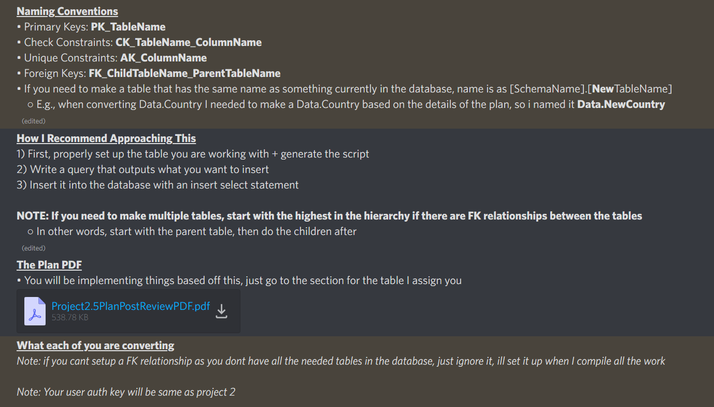
Example: Utilizing Discord to announce deadlines for people, as well as provide information

Slide 17
Group Assistance
Explained how to properly do assigned tasks where confused
Explained how to go about inserting data into the tables made for normalization purposes
Also explaining how to use ORDER BY on insertion to ensure the key-data mapping remains the same from the original table
Explained how to go about joining the tables when making views / functions for non-Data schema table conversions.
Bounced ideas back and forth on how to layout the slides

Slide 18
Use of RedGate

Slide 19
How RedGate Assisted Us
SQLPrompt: Generally useful for auto-fill purposes, and giving default options for INNER JOINS
Toolbar History: Helped recover queries when had closed a window in SSMS and later needing that SQL statement again

Slide 20
To-Do List and Gannt Chart

Slide 21
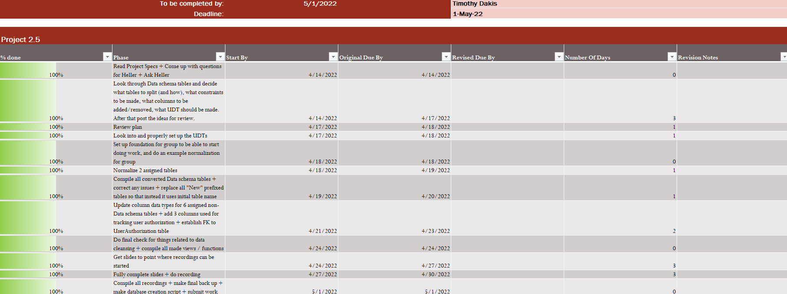
To-Do List For Timothy Dakis

Slide 22
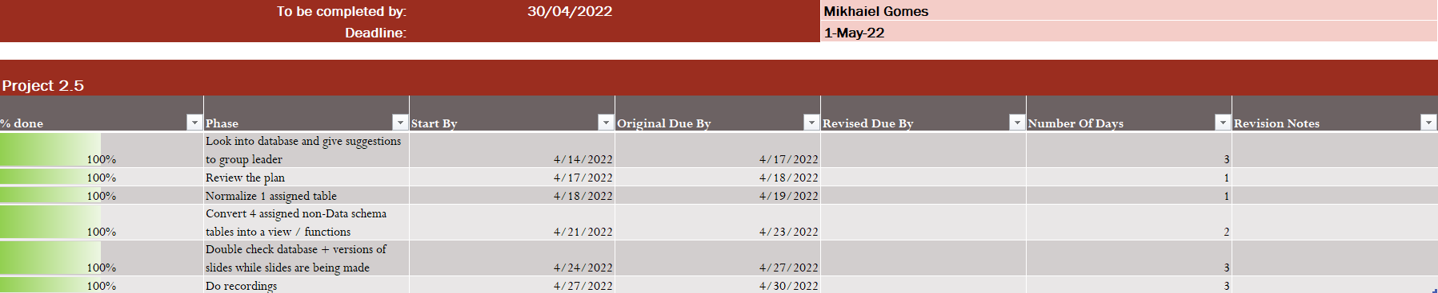
To-Do List For Mikhaiel Gomes

Slide 23

To-Do List For Shivanie Kemraj

Slide 24

To-Do List For Konrad Rakowski

Slide 25

To-Do List For Kevin Tang

Slide 26
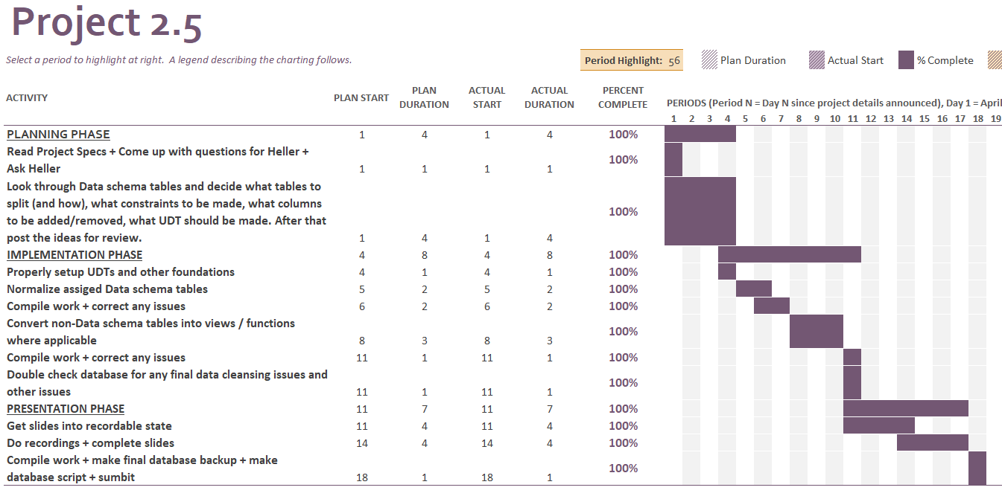
Gannt Chart

Slide 27
The Project Part
This part of the presentation will show aspects related to implementing the project itself in more depth. It will include:
Showcase the WorkFlowStep and UserAuthorization tables
ERD/PDM of the Data schema tables before and after normalization
Data cleansing (why and how things were cleaned)
The UDT hierarchy, along with why each UDT exists, how reusable each one was, and when in the project they were decided
The Data schema table Normalization
Will explain why columns were either added or removed or modified
Will explain why the constraints added were added
Segmented by which tables were done by whom
The conversion of non-Data schema tables into views/functions where applicable
Segmented by which conversions were done by whom
Other things related to implementation

Slide 28
DbSecurity.UserAuthorization and Process.WorkFlowStep

Slide 29
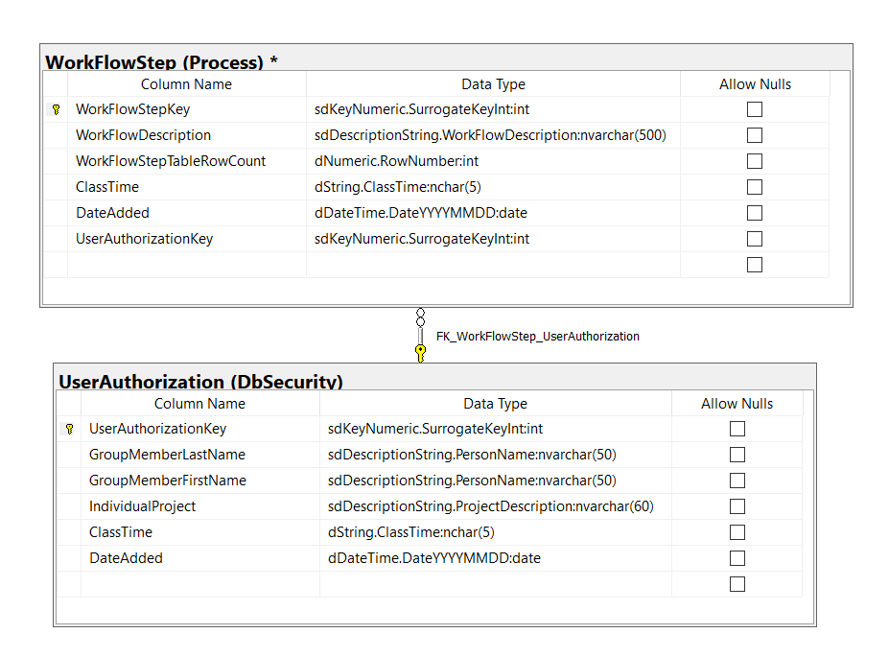
Standard-view PDM of DbSecurity.UserAuthorization and Process.WorkFlowStep

Slide 30
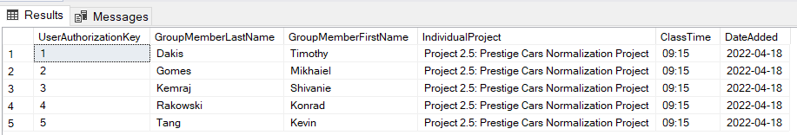
Everything has a FK Relationship with the DbSecurity.UserAuthorization Table

Slide 31
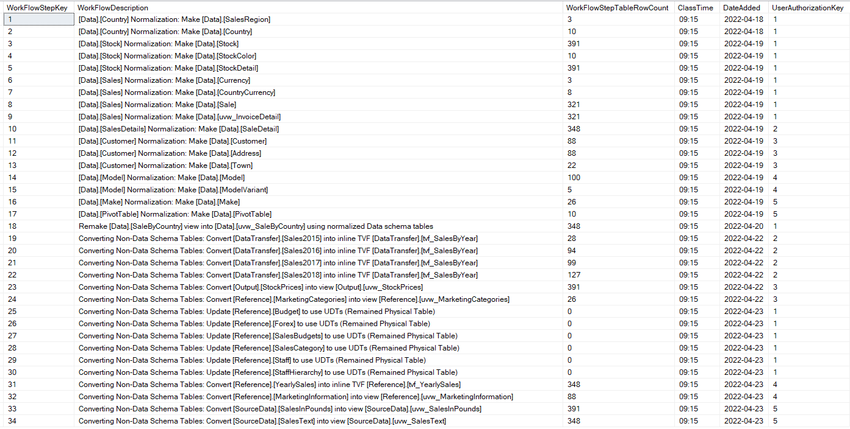
Overview of the Process.WorkFlowStep table

Slide 32
ERD/PDM of the Data schema tables before and after normalization

Slide 33
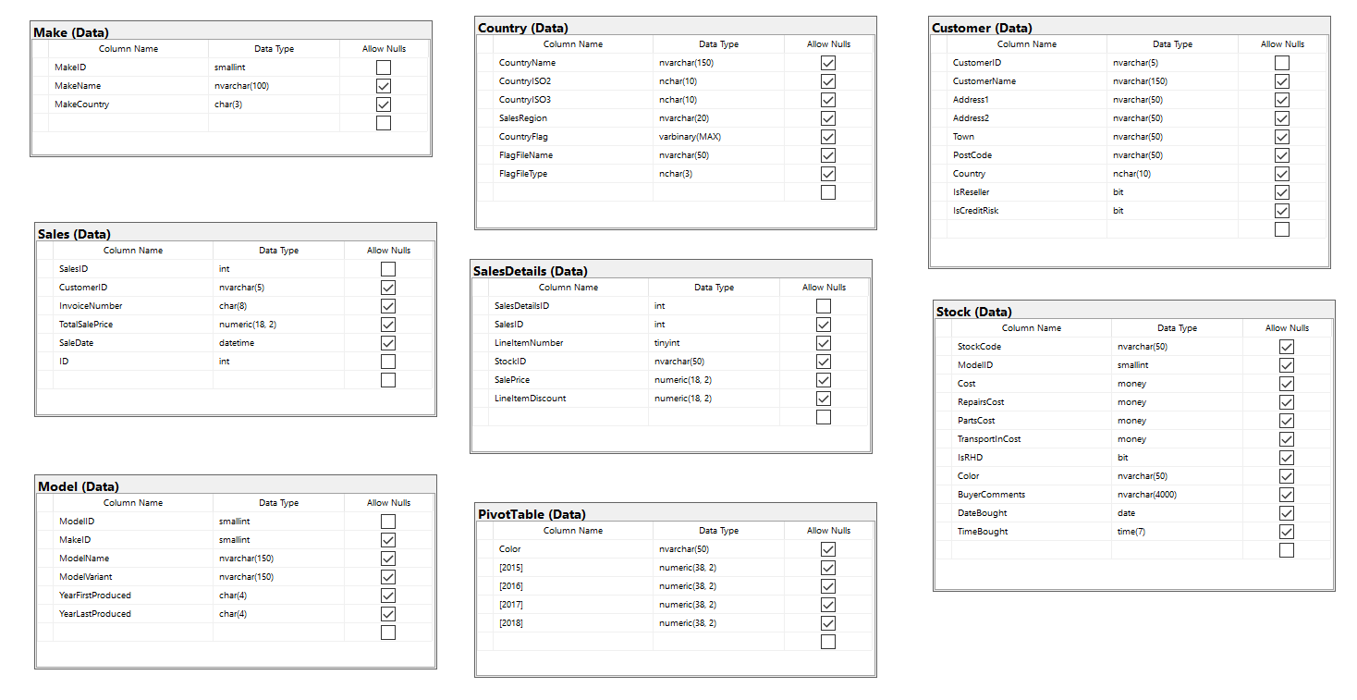
PDM of Original Data Schema Tables

Slide 34
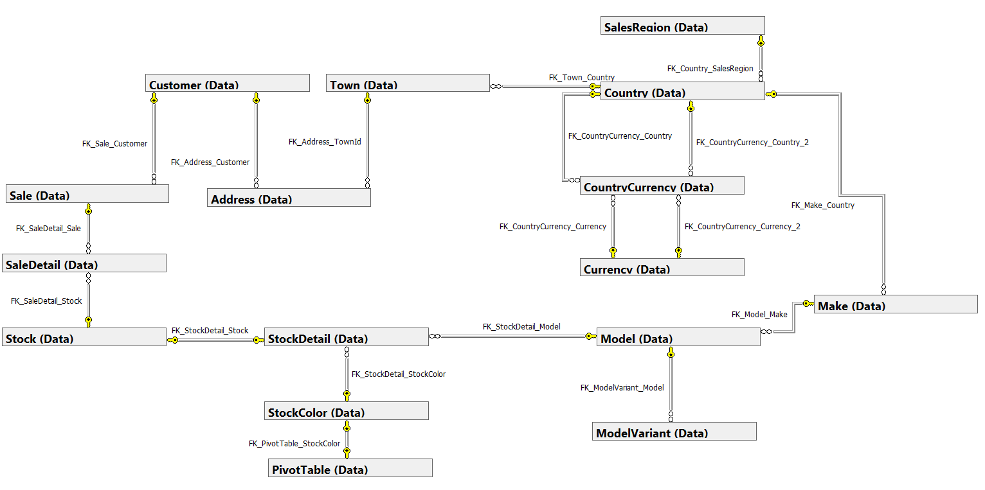
Name-view of Data Schema Tables (Post-Normalization) (Without DbSecurity.UserAuthorization)
Name-view used to fit entire database in 1 screenshot to see all the FK relationships
Standard-view showing UDTS, etc. will be shown for specific sections of this when showing how each individual Data table of the original table was normalized

Slide 35
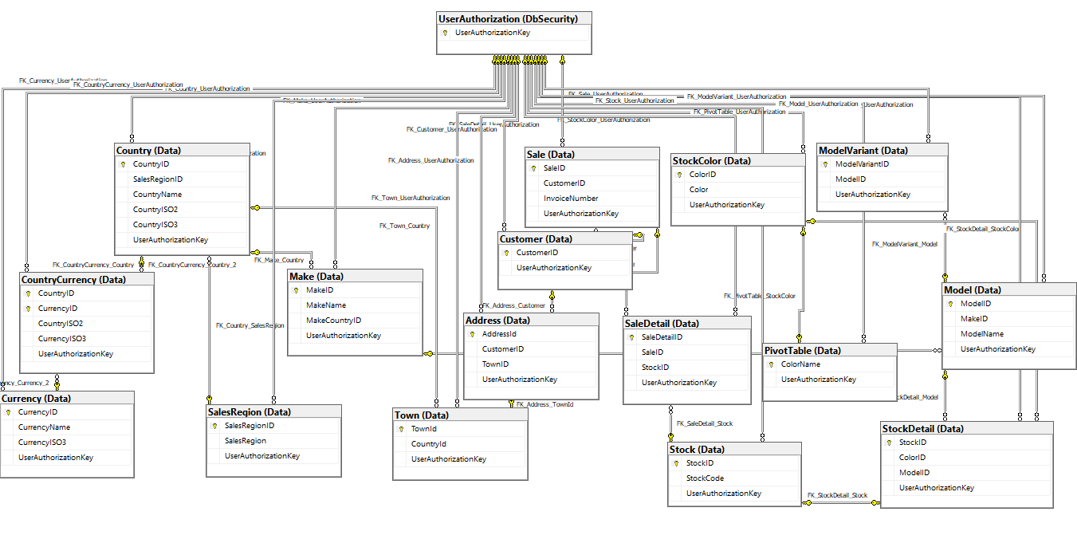
Key-view of Data Schema Tables (Post-Normalization) (With DbSecurity.UserAuthorization)

Slide 36
Data Cleansing

Slide 37
Data Cleansing Part 1: The Row with mostly NULL values in Data.Stock
This was noticed during initial analysis of the database during the planning stage.
It was deemed bad data and cleansed as almost all values were NULL.
Since it was noticed during planning stage, it was easy to account for and to clean out when normalizing the Data.Stock table

Slide 38
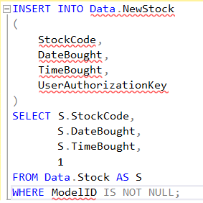
How we Cleaned it
Since noticed pre-normalization, when inserting into the temporary Data.NewStock, simply excluded it from being inserted.
This way it would not be part of the database after transferring Data.NewStock data into the updated Data.Stock.

Slide 39
Data Cleansing Part 2: Non-NULL, but Still Empty ModelVariant Entry
This was noticed during initial analysis of the database during the planning stage.
It was deemed bad data and cleansed as a blank ModelVariant is not a variant.
Since it was noticed during planning stage, it was easy to account for and to clean out when normalizing the Data.Model when putting the variants into its own Data.ModelVariant table

Slide 40
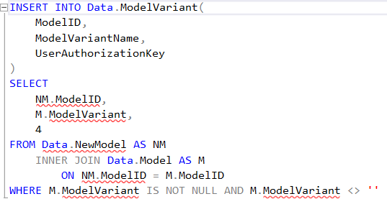
How we Cleaned it
Since noticed pre-normalization, when inserting into the new Data.ModelVariant, simply excluded it from being inserted.
This way it would not be part of the database

Slide 41
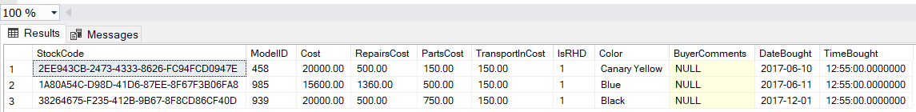
Data Cleansing Part 3: Stock Entries with ModelIDs 458, 939, 985
While this database screenshot is from the pre-normalized Data.Stock, this was an issue we actually noticed after normalizing the database. This made it more challenging to properly cleanse as we needed to ensure it was cleaned from several affected tables.
It was deemed bad data and cleansed as Models of ID 458, 939, and 985 do not exist in Data.Model and thus ruin any referential integrity that would otherwise be established.
Several slides will be dedicated to show screenshots taking during the cleansing to document the process done to clean it properly.

Slide 42
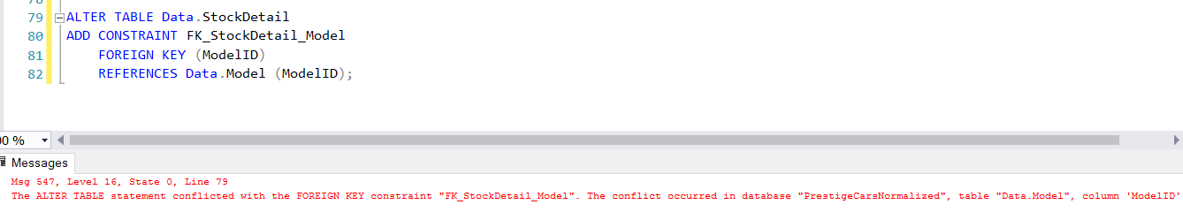
Why it was an Issue:
Since the ModelID in Data.Model only went from 1 to 100, a FK relationship could not be established from Data.StockDetail to Data.Model as Data.StockDetail contained the Model IDs of 458, 939, 985.

Slide 43
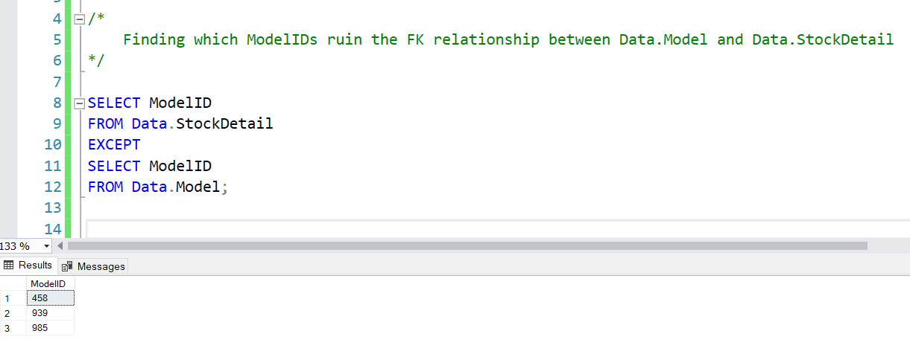
How it was Cleaned Part 1: Checking Which ModelIDs Were Causing the Issue

Slide 44
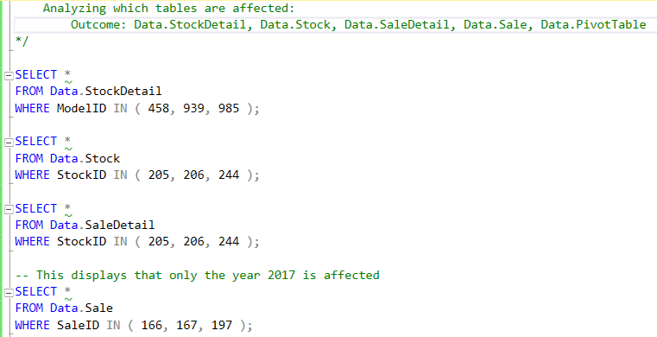
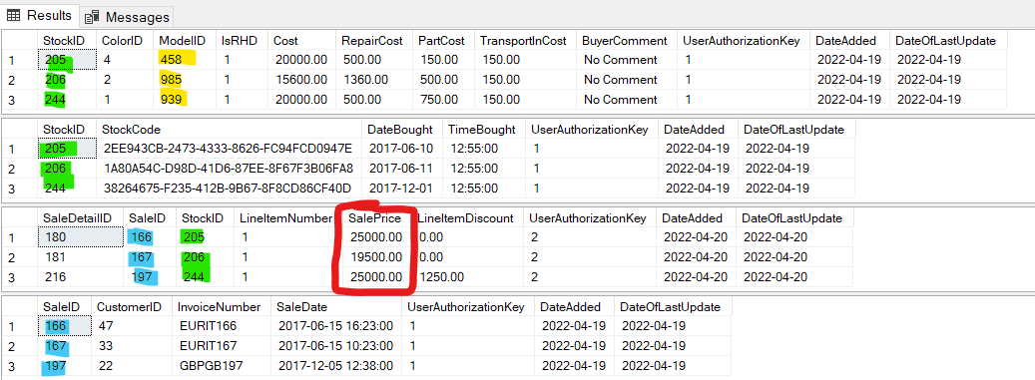
How it was Cleaned Part 2: Finding Affected Tables (1/2)

Slide 45
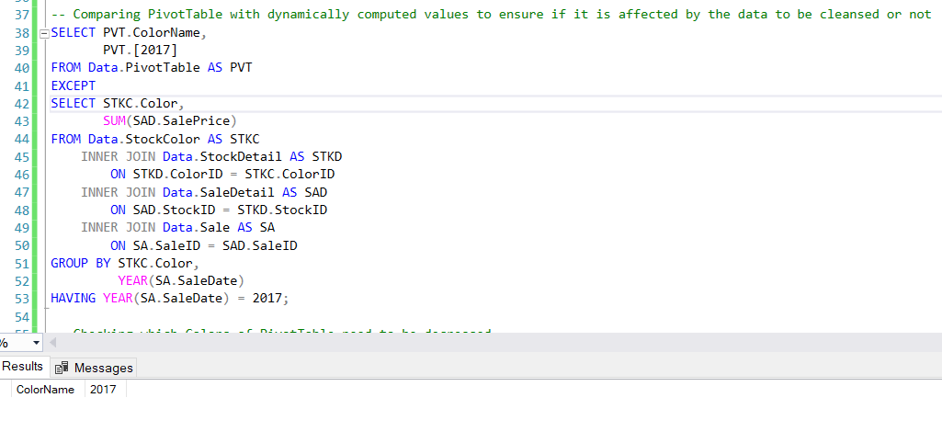
How it was Cleaned Part 3: Finding Affected Tables (2/2)

Slide 46
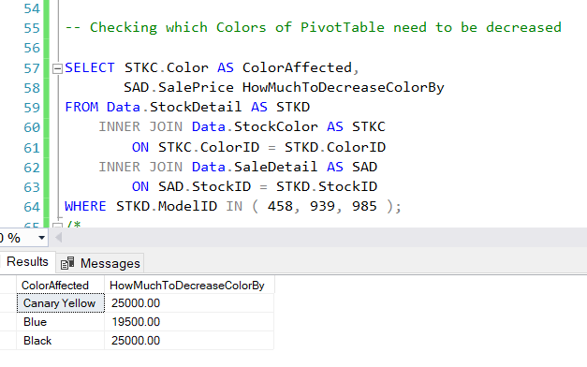
How it was Cleaned Part 4: Checking Which Colors of Data.PivotTable Were Affected, and by how Much

Slide 47
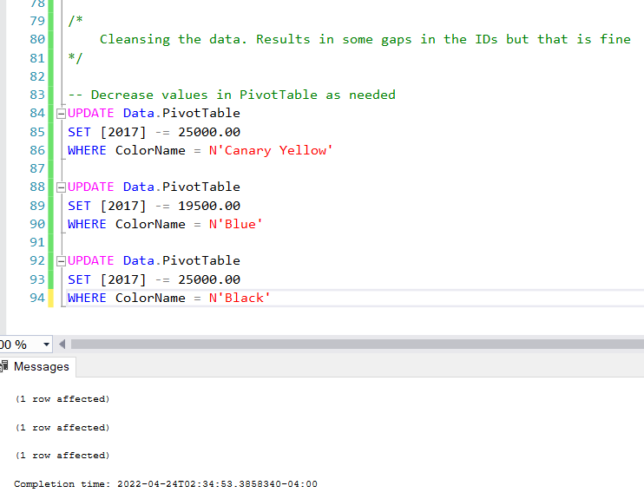
How it was Cleaned Part 5: Clean Data.PivotTable

Slide 48
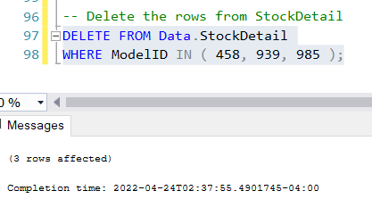
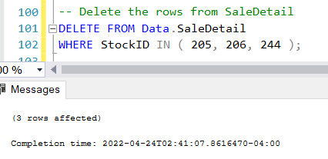
How it was Cleaned Part 6: Clean Data.StockDetail and Data.SaleDetail

Slide 49
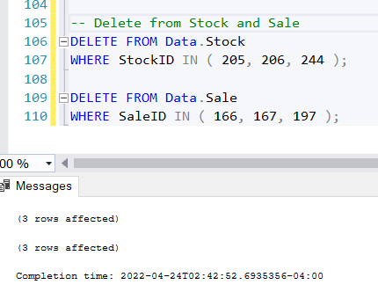
How it was Cleaned Part 7: Clean Data.Stock and Data.SaleDetail
Had to delete from Data.StockDetail and Data.SaleDetail first, so that we do not violate FK relationships when deleting from Data.Stock and Data.Sale

Slide 50
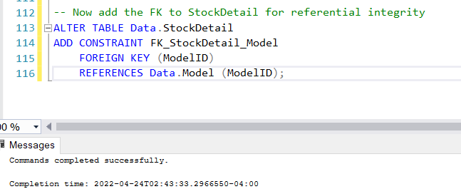
How it was Cleaned Part 8: Add the FK now, as That was Main Goal

Slide 51
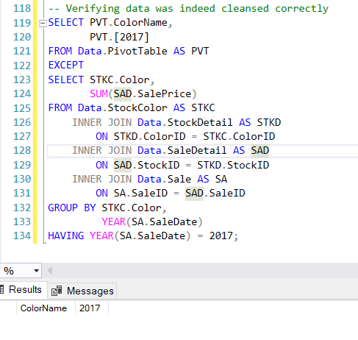
How it was Cleaned Part 9: Verify if Data Cleaned Properly

Slide 52
UDTs (User Defined Data Types)
Layout of this Section:
Show UDT Hierarchies
Break down each UDT (frequency, reason made/for data type, and when in project it was decided)

Slide 53
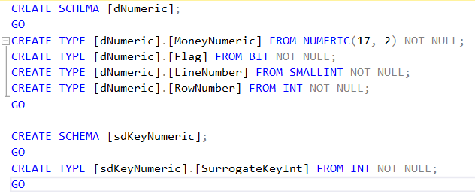
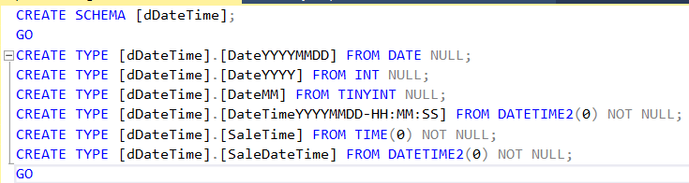
UDT Hierarchy Part 1
Numeric (Domain)
MoneyNumeric (based on NUMERIC(17, 2))
Flag (based on bit)
LineNumber (based on smallint)
RowNumber (based on int)
KeyNumeric (Subdomain)
SurrogateKeyInt (based on INT)
DateTime (Domain)
DateYYYYMMDD (based on date)
DateYYYY (based on int)
SaleTime (based on time(0))
SaleDateTime (based on DATETIME2(0))
DateMM (Based on tinyint)
DateTimeYYYYMMDD-HH:MM:SS (Based on DATETIME(0))

Slide 54
UDT Hierarchy Part 2
String (Domain)
BuyerComment (based on nvarchar(500))
ClassTime (based on nchar(4))
BudgetComment (based on nvarchar(500))
KeyString (Subdomain)
StockCode (based on nchar(36))
Invoice (based on nchar (8))
DescriptionString (Subdomain)
PersonName (based on nvarchar(50))
CurrencyName (based on nvarchar(50))
CurrencySymbol (based on nvarchar(1))
ColorName (based on nvarchar(50))
CarDescription (based on nvarchar(20))
WorkFlowDescription (based on nvarchar(500))
ProjectDescription (based on nvarchar(60))
BudgetDescription (based on nvarchar(50))
CategoryDescription (based on nvarchar(50))
DepartmentDescription (based on nvarchar (50))
String (Domain) (Continued here)
LocationString (Subdomain)
CountryName (based on nvarchar(60))
RegionName (based on nvarchar(20))
TownName (based on nvarchar(50))
Address (based on nvarchar(60))
PostCode (based on nvarchar(9))
ISOString (Subdomain)
ISO2 (based on nchar(2))
ISO3 (based on nchar(3))

Slide 55
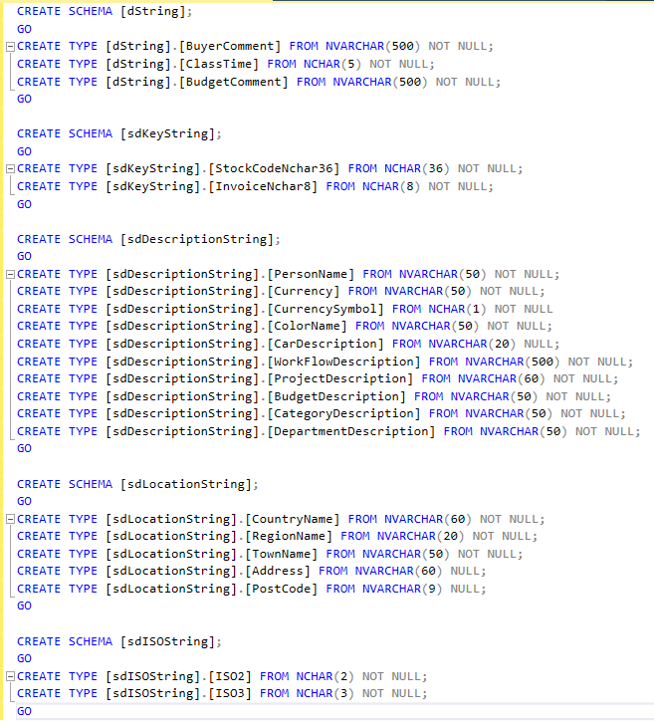
UDT Hierarchy Part 3

Slide 56
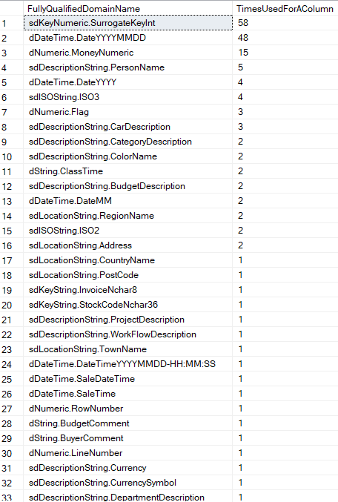
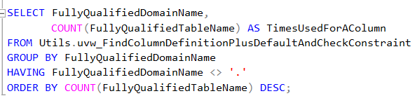
UDT Frequency Table

Slide 57
UDT Breakdown Part 1 (The following UDTs were decided during planning)
Domain Name: | sdKeyNumeric.SurrogateKeyInt
Frequency: | 58
Data Type: | int
Reason: | UDT Reason: Just a reusable data type for surrogate key
Domain Name: | dDateTime.DateYYYYMMDD
Frequency: | 48
Data Type: | date
Reason: | Just a reusable general data type format for dates

Slide 58
UDT Breakdown Part 2
Domain Name: | dNumeric.MoneyNumeric
Frequency: | 15
Data Type: | numeric(17 2)
Reason: | To have a general reusable data type for money purposes. Numeric(17,2) to handle up to trillions which is more than realistically needed for our purposes. Numeric generally seen better for money purposes too due to computational/precision reasons.
Domain Name: | sdDescriptionString.PersonName
Frequency: | 5
Data Type: | nvarchar(50)
Reason: | To have a general reusable data type focused on names. Nvarchar(50) since longest customer name was ~40 characters, so gives a bit more leeway

Slide 59
UDT Breakdown Part 3
Domain Name: | sdISOString.ISO3
Frequency: | 4
Data Type: | nchar(3)
Reason: | To have a UDT specific to ISO3 strings to reduce storage waste of using larger string types. Nchar(3) since they are all 3 characters.
Domain Name: | dDateTime.DateYYYY
Frequency: | 4
Data Type: | int
Reason: | To have a general UDT type for year components of dates. Int since a year is just an integer.

Slide 60
UDT Breakdown Part 4
Domain Name: | dNumeric.Flag
Frequency: | 3
Data Type: | bit
Reason: | To have a reusable UDT for true/false flagging purposes.
Domain Name: | sdDescriptionString.CarDescription
Frequency: | 3
Data Type: | nvarchar(20)
Reason: | To have a reusable UDT for describing specifically components of cars (e.g., model, make). Nvarchar(20) as longest make/ model (variant) was ~15 characters

Slide 61
UDT Breakdown Part 5
Domain Name: | sdDescriptionString.ColorName
Frequency: | 2
Data Type: | nvarchar(50)
Reason: | To have a UDT specific to colors, so it can be easier to pull out columns in tables related to colors since data is summarized by color
Domain Name: | sdISOString.ISO2
Frequency: | 2
Data Type: | nchar(2)
Reason: | To have a UDT specific to ISO3 strings to reduce storage waste of using larger string types. Nchar(2) since they are all 2 characters.

Slide 62
UDT Breakdown Part 6
Domain Name: | dString.ClassTime
Frequency: | 2
Data Type: | nchar(5)
Reason: | To have a UDT specific to class time, which is a fixed 5-character length hence nchar(5), thus minimizing storage waste.
Domain Name: | sdLocationString.Address
Frequency: | 2
Data Type: | nvarchar(60)
Reason: | To have a UDT specific to addresses.

Slide 63
UDT Breakdown Part 7
Domain Name: | sdLocationString.CountryName
Frequency: | 1
Data Type: | nvarchar(60)
Reason: | To have a UDT specific to country names. Nvarchar(60) as longest country name seems to be ~60 characters.
Domain Name: | sdLocationString.RegionName
Frequency: | 2
Data Type: | nvarchar(20)
Reason: | To have a UDT specific to region names.

Slide 64
UDT Breakdown Part 8
Domain Name: | dNumeric.LineNumber
Frequency: | 1
Data Type: | smallint
Reason: | To have a UDT specific to line numbers, set as smallint to minimize storage waste since realistically a singular line number will not get tha tbig
Domain Name: | dDateTime.SaleTime
Frequency: | 1
Data Type: | time(0)
Reason: | To have a UDT specific to when time of a sale occurred. Time(0) since for their purposes, tracking further precision seems unnecessary, thus wasting space.

Slide 65
UDT Breakdown Part 9
Domain Name: | sdKeyString.InvoiceNchar8
Frequency: | 1
Data Type: | nchar(8)
Reason: | To have a UDT specific to invoices, which are in a way a unique key. Nchar(8) as generated invoices are 3 (CurrencyISO3) + 2 (Customer CountryISO2) + 3 (SaleID formatted to 3 digits) = 8 characters long.
Domain Name: | sdKeyString.StockCodeNchar36
Frequency: | 1
Data Type: | nchar(36)
Reason: | To have a UDT specific to stock codes, which are in a way a unique key. Nchar(36) since all stock codes are fixed at 36 characters.

Slide 66
UDT Breakdown Part 10
Domain Name: | sdLocationString.TownName
Frequency: | 1
Data Type: | nvarchar(50)
Reason: | To have a UDT specific to town names.
Domain Name: | dString.BuyerComment
Frequency: | 1
Data Type: | nvarchar(500)
Reason: | To have a UDT specific to buyer comments, made sufficiently large to allow sufficient space for comments, but not as unreasonable as the initial 4000 characters reserved per comment.

Slide 67
UDT Breakdown Part 11
Domain Name: | sdDescriptionString.WorkFlowDescription
Frequency: | 1
Data Type: | nvarchar(500)
Reason: | To have a UDT specific to what occurred in a specific workflow step, giving sufficient space for reasoning.
Domain Name: | sdDescriptionString.ProjectDescription
Frequency: | 1
Data Type: | nvarchar(60)
Reason: | To have a UDT specific to the project itself, given sufficient space for the project description.

Slide 68
UDT Breakdown Part 12
Domain Name: | sdDescriptionString.CurrencySymbol
Frequency: | 1
Data Type: | nchar(1)
Reason: | To have a UDT specific to currency symbols, made nchar(1) to minimize waste as a symbol is only 1 character.
Domain Name: | dNumeric.RowNumber
Frequency: | 1
Data Type: | int
Reason: | To have a UDT specific to tracking the number of rows. Int as realistically can have many rows.

Slide 69
UDT Breakdown Part 13
Domain Name: | dDateTime.SaleDateTime
Frequency: | 1
Data Type: | datetime(0)
Reason: | To have a UDT specific to when date and time of a sale occurred. Datetime(0) since for their purposes, tracking further precision seems unnecessary, thus wasting space.
Domain Name: | sdDescriptionString.Currency
Frequency: | 1
Data Type: | nvarchar(50)
Reason: | To have a UDT specific to currency names, given sufficient space to allow sufficient space for any currency name.

Slide 70
UDT Breakdown Part 14
Domain Name: | sdLocationString.PostCode
Frequency: | 1
Data Type: | nvarchar(9)
Reason: | To have a UDT specific to post codes, set up to minimize storage waste as post codes seemed to be <= 9 characters in the data.
Domain Name:
Frequency:
Data Type:
Reason:

Slide 71
UDT Breakdown Part 15 (The following UDTs were decided after normalizing the Data schema tables)
Domain Name: | sdDescriptionString.BudgetDescription
Frequency: | 2
Data Type: | nvarchar(50)
Reason: | To have a UDT specific to describing what the budget is.
Domain Name: | sdDescriptionString.CategoryDescription
Frequency: | 2
Data Type: | nvarchar(50)
Reason: | To have a UDT specific to what the category is.

Slide 72
UDT Breakdown Part 16
Domain Name: | dDateTime.DateMM
Frequency: | 2
Data Type: | tinyint
Reason: | To have a UDT specific to the month of a date. Tinyint as months only go up to 12.
Domain Name: | dDateTime.DateTimeYYYYMMDD-HH:MM:SS
Frequency: | 1
Data Type: | datetime2(0)
Reason: | To have a general UDT for tracking date and time, made datetime(0) as for the needed purposes tracking further precision seems unnecessary.

Slide 73
UDT Breakdown Part 17
Domain Name: | sdDescriptionString.DepartmentDescription
Frequency: | 1
Data Type: | nvarchar(50)
Reason: | To have a UDT specific to describing a department.
Domain Name: | dString.BudgetComment
Frequency: | 1
Data Type: | nvarchar(500)
Reason: | To have a UDT specific to comment on a budget, given sufficient space to fit in any type of comment.

Slide 74
Data Schema Tables Normalization
This section will include:
PDM of the table before and after normalizing it
PDM showing any FK relationships with other tables post-normalization (if applicable)
Will state overall columns added/removed/modified, and why
Will show constraints, and explain why they were added

Slide 75
To Avoid Repetition: The Following Were Done to Every Table and Will not be Mentioned in the Specific Table Breakdowns
Added the following columns to every table:
UserAuthorizationKey: SurrogateKeyInt, NOT NULL
DateAdded: DateYYYYMMDD, NOT NULL (Default = sysdatetime())
DateOfLastUpdate: DateYYYYMMDD, NOT NULL (Default = sysdatetime())
The following columns were added for purposes of tracking who worked on what, and when it was finally added into the master
The defaults are sysdatetime() simple to auto-generate values in the column easily
Added a FK relationship between every table (the child) to DbSecurity.UserAuthorization (the parent) between their UserAuthorizationKey columns
This was done to create referential integrity to ensure only verified user keys were inputted into the tables
All Primary Keys are Clustered Indices
Just made most sense to allow the tables to be ordered this way, because you are most likely going to be using the tables based on their primary key.
All Alternate Keys (Unique Constraints) are Un-clustered Indices
Was set at un-clustered by default, and makes sense, as it can ensure uniqueness of the column value this way

Slide 76
Tables Normalized by Timothy Dakis
Tables:
Data.Country
Data.Stock
Data.Sales

Slide 77
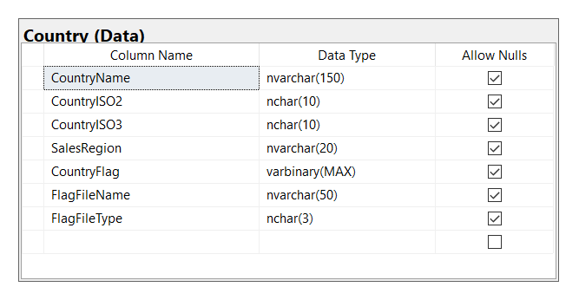
[Data].[Country] Pre-Normalization

Slide 78
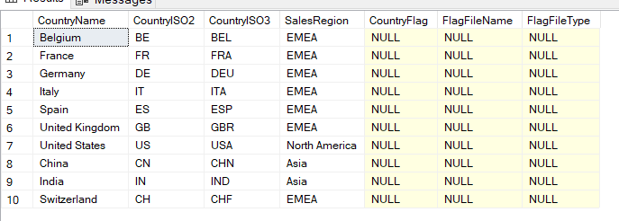
[Data].[Country] Pre-Normalization Output

Slide 79
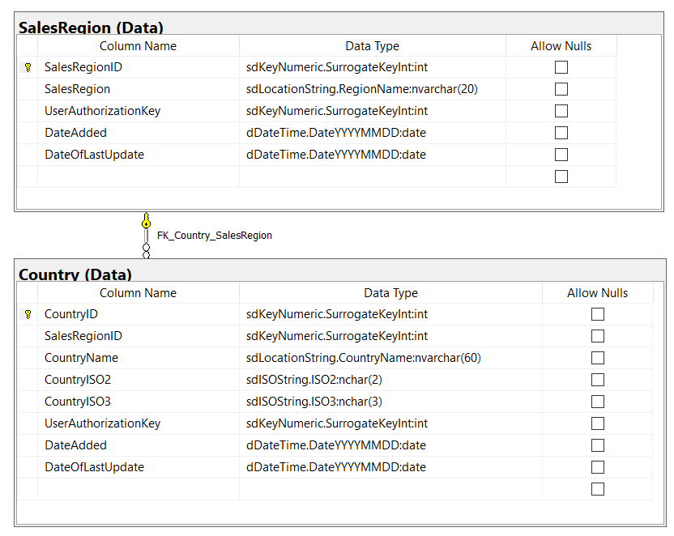
[Data].[Country] Post-Normalization

Slide 80
Steps Taken to Normalize [Data].[Country]
Create Data.SalesRegion, insert relevant data from Data.Country into it
Create Data.NewCountry, insert relevant data from Data.Country into it
Remake Data.Country, shift data from Data.NewCountry into it

Slide 81
Why It Was Broken Down Into the Following Views/Tables
Split Data.Country into Data.SalesRegion and Data.Country
Did this because lots of repeatedly named SalesRegion, made more sense to shift that into its own table and instead reference it via a key for storage purposes

Slide 82
Overall Columns Added/Removed/Modified to Normalize [Data].[Country]
Added Columns:
CountryID
Reason: to act as a PK for Data.Country
SalesRegionID
Reason: to act as a PK for Data.SalesRegion
Removed Columns:
CountryFlag
FlagFileName
FlagFileType
Reason for all 3: only had NULL entries

Slide 83
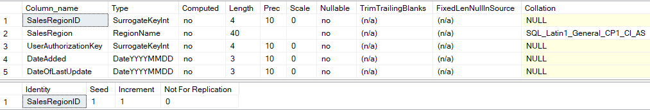
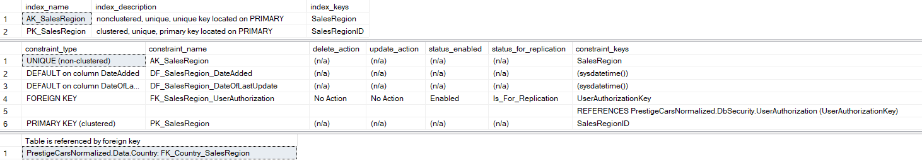
[Data].[SalesRegion] Overview

Slide 84
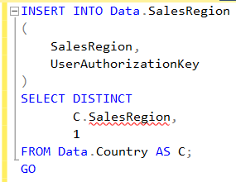
How Insertion Was Done Into [Data].[SalesRegion]

Slide 85
[Data].[SalesRegion] Primary, Foreign, and Alternate Keys (Unique Constraints)
PK_SalesRegion on SalesRegionID
This is because it is a surrogate key
AK_SalesRegion on SalesRegion
Wanted a unique constraint on SalesRegion as it does not make sense to have multiple of the same SalesRegion in the table

Slide 86
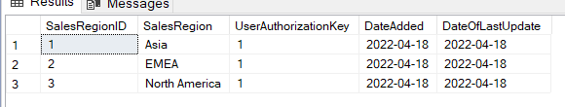
[Data].[SalesRegion] Output

Slide 87
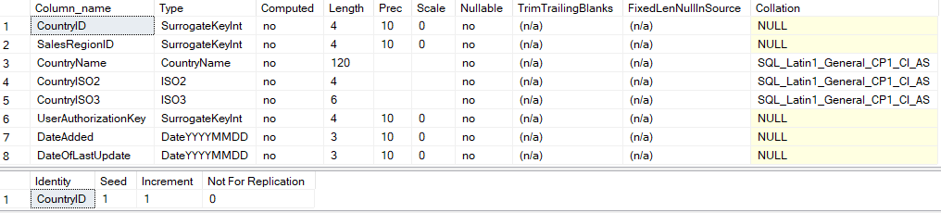
[Data].[Country] Overview

Slide 88
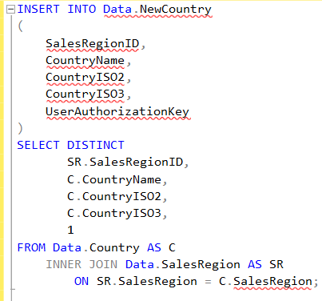
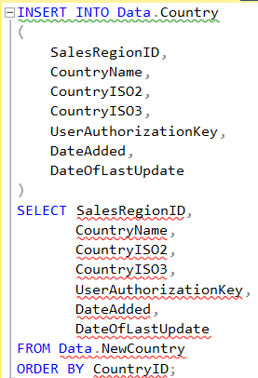
How Insertion Was Done Into [Data].[Country]
To initially fill Data.NewCountry
To then properly set up Data.Country

Slide 89
[Data].[Country] Primary, Foreign, and Alternate Keys (Unique Constraints)
PK_Country on CountryID
This is because it’s a surrogate key
FK_Country_SalesRegion on SalesRegionID
This is to ensure referential integrity to ensure the sales region inserted into Data.Country exists
AK_CountryName on CountryName
AK_CountryISO2 on CountryISO2
AK_CountryISO3 on CountryISO3
These were all set to ensure they are unique column values, as it does not make sense for them to be repeated

Slide 90
[Data].[Country] Check and Default Constraints
CK_Country_CountryISO2
Check Constraint: ([CountryISO2] like N'[A-Z][A-Z]')
CK_Country_CountryISO3
Check Constraint: ([CountryISO3] like N'[A-Z][A-Z][A-Z]’)
These were both set to ensure the ISOs were 2 and 3 letters long respectively

Slide 91
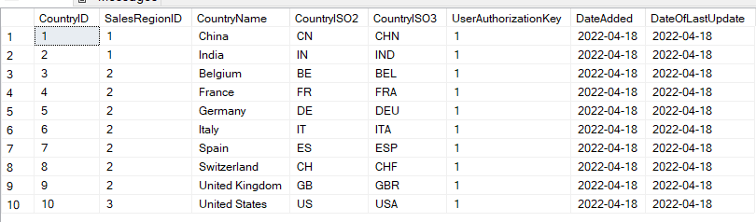
[Data].[Country] Output

Slide 92
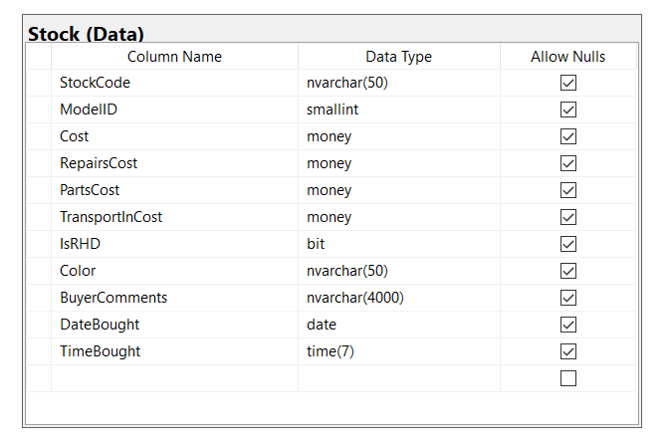
[Data].[Stock] Pre-Normalization

Slide 93
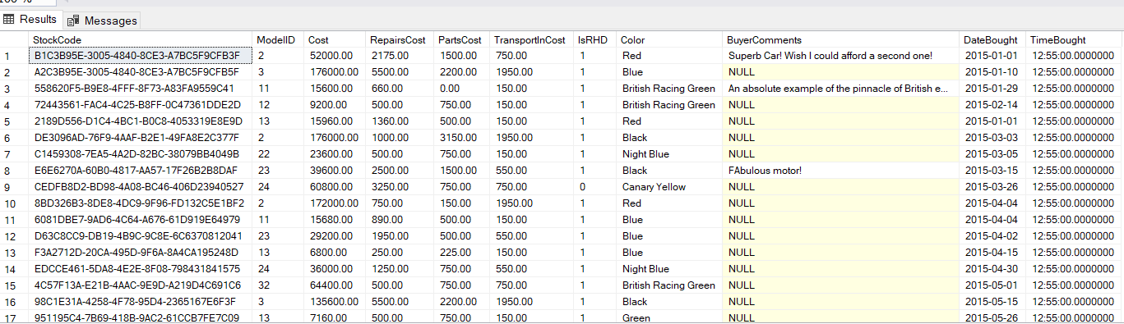
[Data].[Stock] Pre-Normalization Output

Slide 94

[Data].[Stock] Post-Normalization

Slide 95

[Data].[Stock] Post-Normalization FK Relationships (Referenced Tables)

Slide 96
Steps Taken to Normalize [Data].[Stock]
Create Data.NewStock, insert relevant data from Data.Stock into it
Create Data.StockColor, insert relevant data from Data.Stock into it
Create Data.StockDetail, insert relevant data from Data.Stock into it
Remake Data.Stock, shift data from Data.NewStock into it

Slide 97
Why It Was Broken Down Into the Following Views/Tables
Split Data.Stock into Data.Stock, Data.StockColor and Data.StockDetail
Did this so the stocks themselves as is are isolated in their own table, and then all related details are stored in a separate table
Data.StockColor was made so a FK relationship could be made from Data.PivotTable to the colors to ensure that only valid colors were inserted into Data.PivotTable

Slide 98


[Data].[Stock] Overview

Slide 99


How Insertion Was Done Into [Data].[Stock]
Insertion into Data.NewStock
Insertion to remake Data.Stock

Slide 100
[Data].[Stock] Primary, Foreign, and Alternate Keys (Unique Constraints)
PK_Stock on StockID
This is because it’s a surrogate key
AK_StockCode on StockCode
This is to ensure uniqueness of the stock code itself

Slide 101

[Data].[Stock] Output

Slide 102


[Data].[StockColor] Overview

Slide 103

How Insertion Was Done Into [Data].[StockColor]

Slide 104
[Data].[StockColor] Primary, Foreign, and Alternate Keys (Unique Constraints)
PK_StockColor on ColorID
This is because it’s a surrogate key
AK_Color on Color
This is to ensure uniqueness on all color names, so that the table does not contain any repeat colors

Slide 105

[Data].[StockColor] Output

Slide 106

[Data].[StockDetail] Overview (1/2)

Slide 107

[Data].[StockDetail] Overview (2/2)

Slide 108

How Insertion Was Done Into [Data].[StockDetail]

Slide 109
[Data].[StockDetail] Primary, Foreign, and Alternate Keys (Unique Constraints)
PK_StockDetail on StockID
This is because it’s a surrogate key
FK_StockDetail_Stock on StockID
This is to ensure referential integrity, but also because StockID is an identifying relationship as it is used for the primary key so want to ensure that you cannot insert non-existent StockIDs
FK_StockDetail_ModelID on ModelID
This is to ensure referential integrity, it does not make sense to list stocks for models that do not exist in the database, any insertion is likely erroneous
FK_StockDetail_StockColor on StockID
This is to ensure referential integrity, does not make sense to list colors of stock that do not exist in the database, any insertion is likely erroneous if not added to Data.StockColor first

Slide 110
[Data].[StockDetail] Check Constraints
CK_Cost
Check constraint: ([Cost]>=(0))
CK_PartCost
Check constraint: ([PartCost]>=(0))
CK_RepairCost
Check constraint: ([RepairCost]>=(0))
CK_TransportInCost
Check constraint: ([TransportInCost]>=(0))
Reason for the above 4: it does not make sense to have a negative cost

Slide 111
[Data].[StockDetail] Default Constraints
DF_StockDetail_BuyerComment on BuyerComment
Default value: (N'No Comment’)
Reason: Did not want NULL entries, but still need a default if no comment provided
DF_StockDetail_PartCost on PartCost
DF_StockDetail_RepairCost on RepairCost
DF_StockDetail_TransportInCost on TransportInCost
Default of above 3: ((0))
Reason for above 3: Can easily filter out costs of 0 if there may have been an insertion issue but having it as 0 doesn’t negatively affect any computations. Initial cost doesn’t have a default because that should always be known when inserted.

Slide 112

[Data].[StockDetail] Output

Slide 113

[Data].[Sales] Pre-Normalization

Slide 114

[Data].[Sales] Pre-Normalization Output

Slide 115


[Data].[Sales] Post-Normalization
Also made the following view: Data.uvw_InvoiceDetail with the following columns:

Slide 116

[Data].[Sales] Post-Normalization FK Relationships (Referenced Tables)

Slide 117
Steps Taken to Normalize [Data].[Sales]
Create Data.Currency, insert relevant data based on Data.Sales into it
Create Data.CountryCurrency, insert relevant data based on Data.Sales into it
Create Data.Sale, insert relevant data from Data.Sales into it
Create Data.uvw_InvoiceDetail

Slide 118
Why It Was Broken Down Into the Following Views/Tables
Split Data.Sales into Data.Sale, Data.Currency, Data.CountryCurrency, and Data.uvw_InvoiceDetail
Made the currency-related tables as we thought it could be useful to have a table containing data related to currencies used in transaction, as well as a compilation of all the currencies used per country for transactions
In hindsight, Data.CountryCurrency would make more sense as a view
Made Data.uvw_InvoiceDetail as it provides an easy way to get information that can be acquired from the invoice

Slide 119
Overall Columns Added/Removed/Modified to Normalize [Data].[Sales]
Added Columns:
CountryISO3
Reason: to reference Data.Country as a FK, but also get direct access to the ISO
Currency
Reason: to have as a unique value in Data.Currency, give the name of currency
CurrencyISO3
Reason: to have as a unique value in Data.Currency, lets it be used as alternate key so Data.CurrencyCountry can reference Data.Currency and use it as FK
CurrencyOfTransaction
Reason: gives some information of the invoice
CustomerCountry
Reason: gives some information of the invoice
CurrencyID
Reason: to act as a PK in Data.Currency
CurrencySymbol
Reason: to easily be able to acquire a currency’s symbol
Removed Columns:
ID
Reason: redundant column, mirrors SaleID
TotalSalePrice
Reason: it is derived based off Data.SaleDetail, does not make much sense to derive something in a parent from a child, also means it is dependent on SaleDetail and not Sale so not really normalized if done like that
Modified Columns:
SalesID renamed to SaleID
Makes naming more consistent with other tables

Slide 120


[Data].[Currency] Overview

Slide 121

How Insertion Was Done Into [Data].[Currency]

Slide 122
[Data].[Currency] Primary, Foreign, and Alternate Keys (Unique Constraints)
PK_Currency on CurrencyID
This is because it’s a surrogate key
AK_CurrencyName on CurrencyName
AK_CurrencyISO3 on CurrencyISO3
The above 2 are to ensure uniqueness on the name and ISO3 insertions into the table

Slide 123
[Data].[Currency] Check and Default Constraints
CK_CurrencyISO3
Check Constraint: ([CurrencyISO3] like N'[A-Z][A-Z][A-Z]’)
Reason: To ensure the ISO is 3 letters long

Slide 124

[Data].[Currency] Output

Slide 125


[Data].[CountryCurrency] Overview

Slide 126

How Insertion Was Done Into [Data].[CountryCurrency]

Slide 127
[Data].[CountryCurrency] Primary, Foreign, and Alternate Keys (Unique Constraints)
PK_CountryCurrency on CountryID and CurrencyID
Because it’s a surrogate key, and composite key. This is a bridge table so uses both PKs of the parent tables to make its PK
FK_CountryCurrency_Country on CountryID
FK_CountryCurrency_Country_2 on CountryISO2
FK_CountryCurrency_Currency on CurrencyID
FK_CountryCurrency_Currency_2 on CurrencyISO3
The above 4 are for referential integrity. Firstly, to ensure only currency and countries registered in the database are included in the bridge table. Secondly, to ensure that the composite key is valid as it is based on the CountryID and CurrencyID

Slide 128
[Data].[CountryCurrency] Check and Default Constraints
CK_CountryCurrency_CountryISO2
Check Constraint: ([CountryISO2] like N'[A-Z][A-Z]')
CK_CountryCurrency_CurrencyISO3
Check Constraint: ([CurrencyISO3] like N'[A-Z][A-Z][A-Z]’)
Reason: To ensure the ISOs are 2 or 3 letters long respectively

Slide 129

[Data].[CountryCurrency] Output

Slide 130


[Data].[Sale] Overview

Slide 131

How Insertion Was Done Into [Data].[Sale]

Slide 132
[Data].[Sale] Primary, Foreign, and Alternate Keys (Unique Constraints)
PK_Sale on SaleID
Because it’s a surrogate key
AK_InvoiceNumber on InvoiceNumber
To ensure uniqueness, since the invoice number is in part built off sale id, so if the id is unique then logically the invoice should also be unique too
FK_Sale_Customer on CustomerID
To ensure referential integrity on customer id, does not make sense to log sales for customers that do not exist

Slide 133
[Data].[Sale] Check and Default Constraints
CK_Sale_InvoiceNumber
Check Constraint: ([InvoiceNumber] like N'[A-Z][A-Z][A-Z][A-Z][A-Z][0-9][0-9][0-9]’)
Reason: all invoices generated are 3 (CurrencyISO3) + 2 (Customer CountryISO2) + 3 (SaleID formatted to 3 digits) = 8 characters long

Slide 134

[Data].[Sale] Output

Slide 135

[Data].[uvw_InvoiceDetail] Definition

Slide 136

[Data].[uvw_InvoiceDetail] Output

Slide 137
Tables Normalized by Mikhaiel Gomes
Tables:
Data.SalesDetails

Slide 138

[Data].[SalesDetails] Pre-Normalization

Slide 139

[Data].[SalesDetails] Pre-Normalization Output

Slide 140

[Data].[SalesDetails] Post-Normalization

Slide 141

[Data].[SalesDetails] Post-Normalization FK Relationships (Referenced Tables)

Slide 142
Steps Taken to Normalize [Data].[SalesDetails]
Create Data.SaleDetail, shift data from Data.SalesDetails into it

Slide 143
Overall Columns Added/Removed/Modified to Normalize [Data].[SalesDetails]
Modified Columns:
SalesDetailID renamed to SaleDetailID
Reason: make naming more consistent

Slide 144


[Data].[SaleDetail] Overview

Slide 145

How Insertion Was Done Into [Data].[SaleDetail]

Slide 146
[Data].[SaleDetail] Primary, Foreign, and Alternate Keys (Unique Constraints)
PK_SaleDetailID on SaleDetailID
Because it’s a surrogate key
FK_SaleDetail_Sale on SaleID
FK_SaleDetail_Stock on StockID
The above 2 are to ensure referential identity. Does not make sense to have a sale detail on a sale that doesn’t exist, also does not make sense to reference stock that doesn’t exist in the sale detail

Slide 147
[Data].[SaleDetail] Check and Default Constraints
DF_SaleDetail_LineItemDiscount
Default value:
Reason: If no discount inserted, then there just is not discount
CK_SaleDetail_LineItemDiscount
Check Constraint: ([LineItemDiscount]>=(0))
CK_SaleDetail_LineItemNumber
Check Constraint: ([LineItemNumber]>(0))
CK_SaleDetail_SalePrice
Check Constraint: ([SalePrice]>=(0))
Reason for above 3: Doesn’t make sense for any of them to be able to be negative

Slide 148

[Data].[SaleDetail] Output

Slide 149
Tables Normalized by Shivanie Kemraj
Tables:
Data.Customer

Slide 150

[Data].[Customer] Pre-Normalization

Slide 151

[Data].[Customer] Pre-Normalization Output

Slide 152

[Data].[Customer] Post-Normalization

Slide 153

[Data].[Customer] Post-Normalization FK Relationships (Referenced Tables)

Slide 154
Steps Taken to Normalize [Data].[Customer]
Create Data.NewCustomer, insert relevant data from Data.Customer into it
Create Data.Town, insert relevant data from Data.Customer into it
Create Data.Address, insert relevant data from Data.Customer into it
Remake Data.Customer, shift data from Data.NewCustomer into it

Slide 155
Why It Was Broken Down Into the Following Views/Tables
Split Data.Customer into Data.Customer, Data.Town and Data.Address
Did this so each table was a lot more focused (e.g., only directly customer-related info is in Customer table), and to reduce redundancy in data per table (makes more sense to reference a town via an int key over the nvarchar string)

Slide 156
Overall Columns Added/Removed/Modified to Normalize [Data].[Customer]
Added Columns:
AddressID
Reason: to act as the PK for Data.Address
TownID
Reason: to act as the PK for Data.Town
CountryID
Reason: to reference Data.Country as a FK in Data.Town
Removed Columns:
Country
Reason: replaced with CountryID as a means of acting as a FK
Modified Columns:
CustomerID: Changed from XXXX string to an int
Reason: less space used

Slide 157


[Data].[Customer] Overview

Slide 158


How Insertion Was Done Into [Data].[Customer]
Insertion into Data.NewCustomer
Insertion to remake Data.Customer

Slide 159
[Data].[Customer] Primary, Foreign, and Alternate Keys (Unique Constraints)
PK_Customer on CustomerID
Because it’s a surrogate key

Slide 160

[Data].[Customer] Output

Slide 161


[Data].[Town] Overview

Slide 162

How Insertion Was Done Into [Data].[Town]

Slide 163
[Data].[Town] Primary, Foreign, and Alternate Keys (Unique Constraints)
PK_Town on TownID
Because it’s a surrogate key
FK_Town_Country on CountryID
To ensure referential integrity, does not make sense to list towns in the database if we do not know which country specifically it refers to

Slide 164

[Data].[Town] Output

Slide 165


[Data].[Address] Overview

Slide 166

How Insertion Was Done Into [Data].[Address]

Slide 167
[Data].[Address] Primary, Foreign, and Alternate Keys (Unique Constraints)
PK_Address on AddressID
Because it’s a surrogate key
FK_Address_Customer on CustomerID
FK_Address_TownId on TownID
Reason for above 2: To ensure referential integrity, as it does not make sense to list addresses for towns not in the database, nor for customers that do not exist

Slide 168

[Data].[Address] Output

Slide 169
Tables Normalized by Konrad Rakowski
Tables:
Data.Model

Slide 170

[Data].[Model] Pre-Normalization

Slide 171

[Data].[Model] Pre-Normalization Output

Slide 172

[Data].[Model] Post-Normalization

Slide 173

[Data].[Model] Post-Normalization FK Relationships (Referenced Tables)

Slide 174
Steps Taken to Normalize [Data].[Model]
Create Data.NewModel, insert relevant data from Data.Model into it
Create Data.ModelVariant, insert relevant data from Data.Model into it
Remake Data.Model, shift data from Data.NewModel into it

Slide 175
Why It Was Broken Down Into the Following Views/Tables
Split Data.Model into Data.Model and Data.ModelVariant
Did this because there were many models without a specified variant, so it made more sense to split off variants into its own table to reduce redundancy

Slide 176
Overall Columns Added/Removed/Modified to Normalize [Data].[Model]
Added Columns:
ModelVariantID
Reason: to use as a PK in Data.ModelVariant
Modified Columns:
ModelVariant renamed to ModelVariantName
Reason: name more fitting now that it is in Data.ModelVariant table

Slide 177


[Data].[Model] Overview

Slide 178


How Insertion Was Done Into [Data].[Model]
Insert into Data.NewModel
Insert to remake Data.Model

Slide 179
[Data].[Model] Primary, Foreign, and Alternate Keys (Unique Constraints)
PK_Model on ModelID
Because it’s a surrogate key
AK_ModelName on ModelName
Since variants are now in its own table, only makes sense to list each model name once, and would assume they will not be repeated due to legal reasons
FK_Model_Make on MakeID
To ensure referential integrity, doesn’t make sense to list models for makes not part of the database

Slide 180
[Data].[Model] Check and Default Constraints
CK_Model_YearFirstProduced
Check Constraint: ([YearFirstProduced] IS NULL OR [YearFirstProduced]>(1900))
Reason: If the first year is unknown, it would be NULL, but if it is known it realistically would not make sense for it to be prior to 1900
CK_Model_YearLastProduced
Check Constraint: ([YearLastProduced] IS NULL OR [YearLastProduced]<=(datepart(year,sysdatetime())+(1)))
Reason: If the last year is unknown, it would be NULL, but if known it cannot be after the year after the current year since car manufacturing is only a year in advance at most

Slide 181

[Data].[Model] Output

Slide 182


[Data].[ModelVariant] Overview

Slide 183

How Insertion Was Done Into [Data].[ModelVariant]

Slide 184
[Data].[ModelVariant] Primary, Foreign, and Alternate Keys (Unique Constraints)
PK_ModelVariant on ModelVariantID
Because it’s a surrogate key
FK_ModelVariant_Model on ModelID
To ensure referential integrity, does not make sense to store variants of models not in the database

Slide 185

[Data].[ModelVariant] Output

Slide 186
Tables Normalized by Kevin Tang
Tables:
Data.Make
Data.PivotTable

Slide 187

[Data].[Make] Pre-Normalization

Slide 188

[Data].[Make] Pre-Normalization Output

Slide 189

[Data].[Make] Post-Normalization

Slide 190

[Data].[Make] Post-Normalization FK Relationships (Referenced Tables)

Slide 191
Steps Taken to Normalize [Data].[Make]
Create Data.NewMake, insert relevant data from Data.Make into it
Remake Data.Make, shift data from Data.Make into it

Slide 192
Overall Columns Added/Removed/Modified to Normalize [Data].[Make]
Added Columns:
MakeCountryID
Reason: to reference Data.Country as a FK
Removed Columns:
MakeCountry
Reason: replaced with MakeCountryID to use as FK

Slide 193


[Data].[Make] Overview

Slide 194


How Insertion Was Done Into [Data].[Make]
Insert into Data.NewMake
Insert to remake Data.Make

Slide 195
[Data].[Make] Primary, Foreign, and Alternate Keys (Unique Constraints)
PK_Make on MakeID
Because it’s a surrogate key
AK_MakeName on MakeName
To ensure uniqueness, as it does not make sense to have repeat make names, especially for legal reasons
FK_Make_Country on CountryID
To ensure referential integrity, doesn’t make sense to use countries that don’t exist in the database

Slide 196

[Data].[Make] Output

Slide 197

[Data].[PivotTable] Pre-Normalization

Slide 198

[Data].[PivotTable] Pre-Normalization Output

Slide 199

[Data].[PivotTable] Post-Normalization

Slide 200

[Data].[PivotTable] Post-Normalization FK Relationships (Referenced Tables)

Slide 201
Steps Taken to Normalize [Data].[PivotTable]
Create Data.NewPivotTAble, insert relevant data from Data.PivotTable into it
Remake Data.PivotTable, shift data from Data.PivotTable into it

Slide 202


[Data].[PivotTable] Overview

Slide 203


How Insertion Was Done Into [Data].[PivotTable]
Insert into Data.NewPivotTable
Insert to remake Data.PivotTable

Slide 204
[Data].[PivotTable] Primary, Foreign, and Alternate Keys (Unique Constraints)
PK_PivotTable on Color
Because each color is meant to be unique, as it is tracking how much made per year per stock color
FK_PivotTable_StockColor on Color
To ensure referential integrity and to ensure all primary keys of Data.PivotTable is valid, because it does not make sense to allow the tracking of sales of a color for colors not in the database

Slide 205
[Data].[PivotTable] Check and Default Constraints
CK_PivotTable_2015
Check Constraint: ([2015]>=(0))
CK_PivotTable_2016
Check Constraint: ([2016]>=(0))
CK_PivotTable_2017
Check Constraint: ([2017]>=(0))
CK_PivotTable_2018
Check Constraint: ([2018]>=(0))
Reason for these because it doesn’t make sense for total revenue to be negative

Slide 206

[Data].[PivotTable] Output

Slide 207
Conversion of non-Data Schema Tables into Views/Functions Where Applicable

Slide 208
Timothy Dakis’ Conversions
Tables:
[Reference].[Budget]
[Reference].[Forex]
[Reference].[SalesBudgets]
[Reference].[SalesCategory]
[Reference].[Staff]
[Reference].[StaffHierarchy]

Slide 209

Tables Before Updating Them (None could be converted)

Slide 210

Tables After Updating

Slide 211
Mikhaiel Gomes’ Conversions
Tables:
[DataTransfer].[Sales2015]
[DataTransfer].[Sales2016]
[DataTransfer].[Sales2017]
[DataTransfer].[Sales2018]

Slide 212

Converting [DataTransfer].[Sales2015] to [DataTransfer].[Sales2018] into function [DataTransfer].[tvf_SalesByYear]

Slide 213

Output of [DataTransfer].[tvf_SalesByYear] (2015)

Slide 214

Output of [DataTransfer].[tvf_SalesByYear] (2016)

Slide 215

Output of [DataTransfer].[tvf_SalesByYear] (2017)

Slide 216

Output of [DataTransfer].[tvf_SalesByYear] (2018)

Slide 217


Difference Between the Function and the Original Table Part 1:
This shows differences in outputs

Slide 218

Difference Between the Function and the Original Table Part 2:
Differences in output is a result in difference of data used to create each

Slide 219
Shivanie Kemraj’s Conversions
Tables:
[Output].[StockPrices]
[Reference].[MarketingCategories]

Slide 220

Converting [Output].[StockPrices] into View [Output].[uvw_StockPrices]

Slide 221

Output of [Output].[uvw_StockPrices]

Slide 222



Difference Between the View and the Original Table:
The above and left screenshots show that the make name and of model “360” differ. The right screenshot shows the make name of model “Testarossa” is different. So, some of the differences are as a result of erroneous data in original table.
There are also other differences due to size of data (there are more rows in the view)

Slide 223

Converting [Reference].[MarketingCategories] into View [Reference].[uvw_MarketingCategories]

Slide 224

Output of [Reference].[uvw_MarketingCategories]
Since the MarketingType column violates first normal form (as multiple values in 1 column), a potentially better approach would have to been to break marketing type into its own table, and then make a bridge table between this MarketingType table and the MakeName table. Though the specifications requested a view, and so a view was made

Slide 225
Konrad Rakowski’s Conversions
Tables:
[Reference].[MarketingInformation]
[Reference].[YearlySales]

Slide 226


Converting [Reference].[MarketingInformation] into View [Reference].[uvw_MarketingInformation]

Slide 227

Output of [Reference].[uvw_MarketingInformation]

Slide 228

Converting [Reference].[YearlySales] into Function [Reference].[tvf_YearlySales]

Slide 229

Output of [Reference].[tvf_YearlySales] (2015)

Slide 230

Output of [Reference].[tvf_YearlySales] (2016)

Slide 231

Output of [Reference].[tvf_YearlySales] (2017)

Slide 232

Output of [Reference].[tvf_YearlySales] (2018)

Slide 233
Difference Between the Function and the Original Table:
Different data sources
Original table also had fewer data assumed (only 2015 and 2016), but function can show 2015 -> 2018

Slide 234
Kevin Tang’s Conversions
Tables:
[SourceData].[SalesInPounds]
[SourceData].[SalesText]

Slide 235

Converting [SourceData].[SalesInPounds] into View [SourceData].[uvw_SalesInPounds]

Slide 236

Output of [SourceData].[uvw_SalesInPounds]

Slide 237
Difference Between the View and the Original Table:
The view just has more data, all other data matches up

Slide 238

Converting [SourceData].[SalesText] into View [SourceData].[uvw_SalesText]

Slide 239

Output of [SourceData].[uvw_SalesText]

Slide 240


Difference Between the View and the Original Table:
Different data sets (everything matches except ones appended with USD, but view also has more data contained on top of that)
Some cost column values in original append a "USD"

Slide 241
Other Things Related To Implementation
Remaking Data.SalesByCountry using normalized database
Remade into Data.uvw_SaleByCountry

Slide 242

Data.SalesByCountry Definition (Pre-Normalization)

Slide 243

Data.uvw_SaleByCountry Definition (Post-Normalization)

Slide 244

Data.uvw_SalesByCountry Output

Slide 245

Proof That Both Views Give Same Output

Slide 246

Proof That Both Views Give Same Output

Slide 247
Brief Breakdown of WorkFlowStep (Summary of Work Done)

Slide 248

Contributions of Timothy Dakis

Slide 249

Contributions of Mikhaiel Gomes

Slide 250

Contributions of Shivanie Kemraj

Slide 251

Contributions of Konrad Rakowski

Slide 252

Contributions of Kevin Tang

